Slide 1
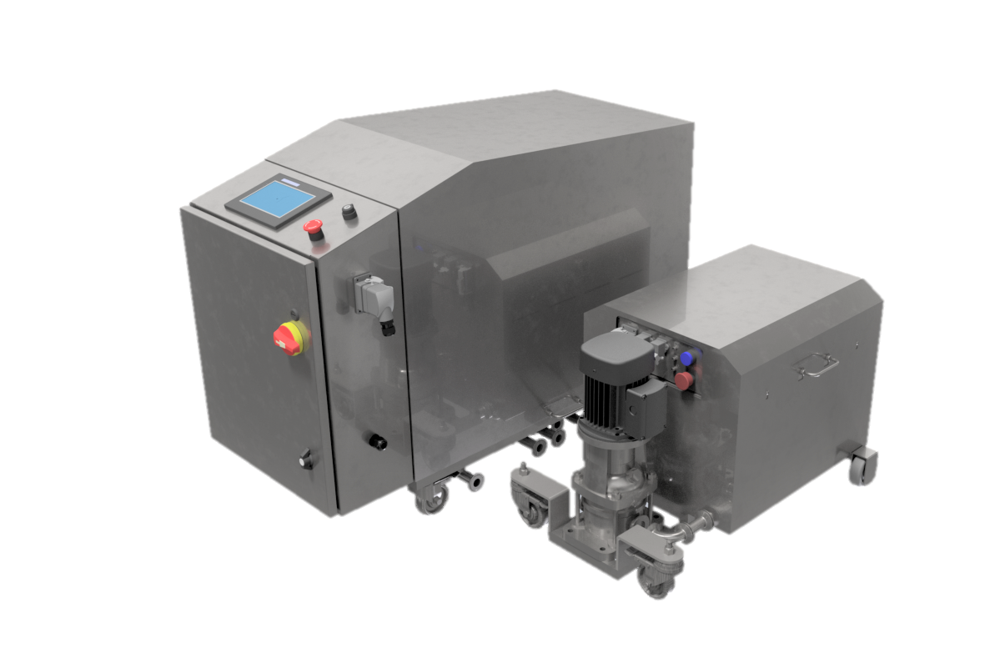
Homogenizer Water Recycling
Overview Presentation | 03.03.2021 | Private & Confidential | Patent Pending | Blue Way Technologies LLC ® 2021

Slide 2
Homogenizer Water Consumption
Average Homogenizer Consumption:
Over 2 million gallons (7.5 million liters) of cooling water per year
Based on flow of 6 GPM (1,350 LPH), 18 hours a day, 6 days a week, 52 weeks a year
Average Water Rates (USA):
$0.02 / GAL for combined municipal supply and wastewater*
Homogenizer Annual Average Water Cost (USA):
$40,000 +
*Source: Water and Wastewater Annual Price Escalation Rates for Selected Cities across the United States (https://www.energy.gov/sites/prod/files/2017/10/f38/water_ wastewater_escalation_rate_study.pdf)

Slide 3
HWRS Models
HWRS-S
Single water recycling return to a single homogenizer
One Sanitation Skid with one Tank Skid
HWRS-S+
Dual water recycling return to a single homogenizer
One Sanitation Skid with one Tank Skid
HWRS-D
Single Water return to two homogenizers
One Sanitation Skid with two Tank Skids

Slide 4
HWRS Functionality
Closed Loop Water Recycling System Featuring:
Continuous water quality and temperature monitoring and control
Redundant water supply safety features
Plug-and-play integration with automatic functionality
Integration with new-build and retrofit
Complete washdown construction
Simple user interface and operation

Slide 5
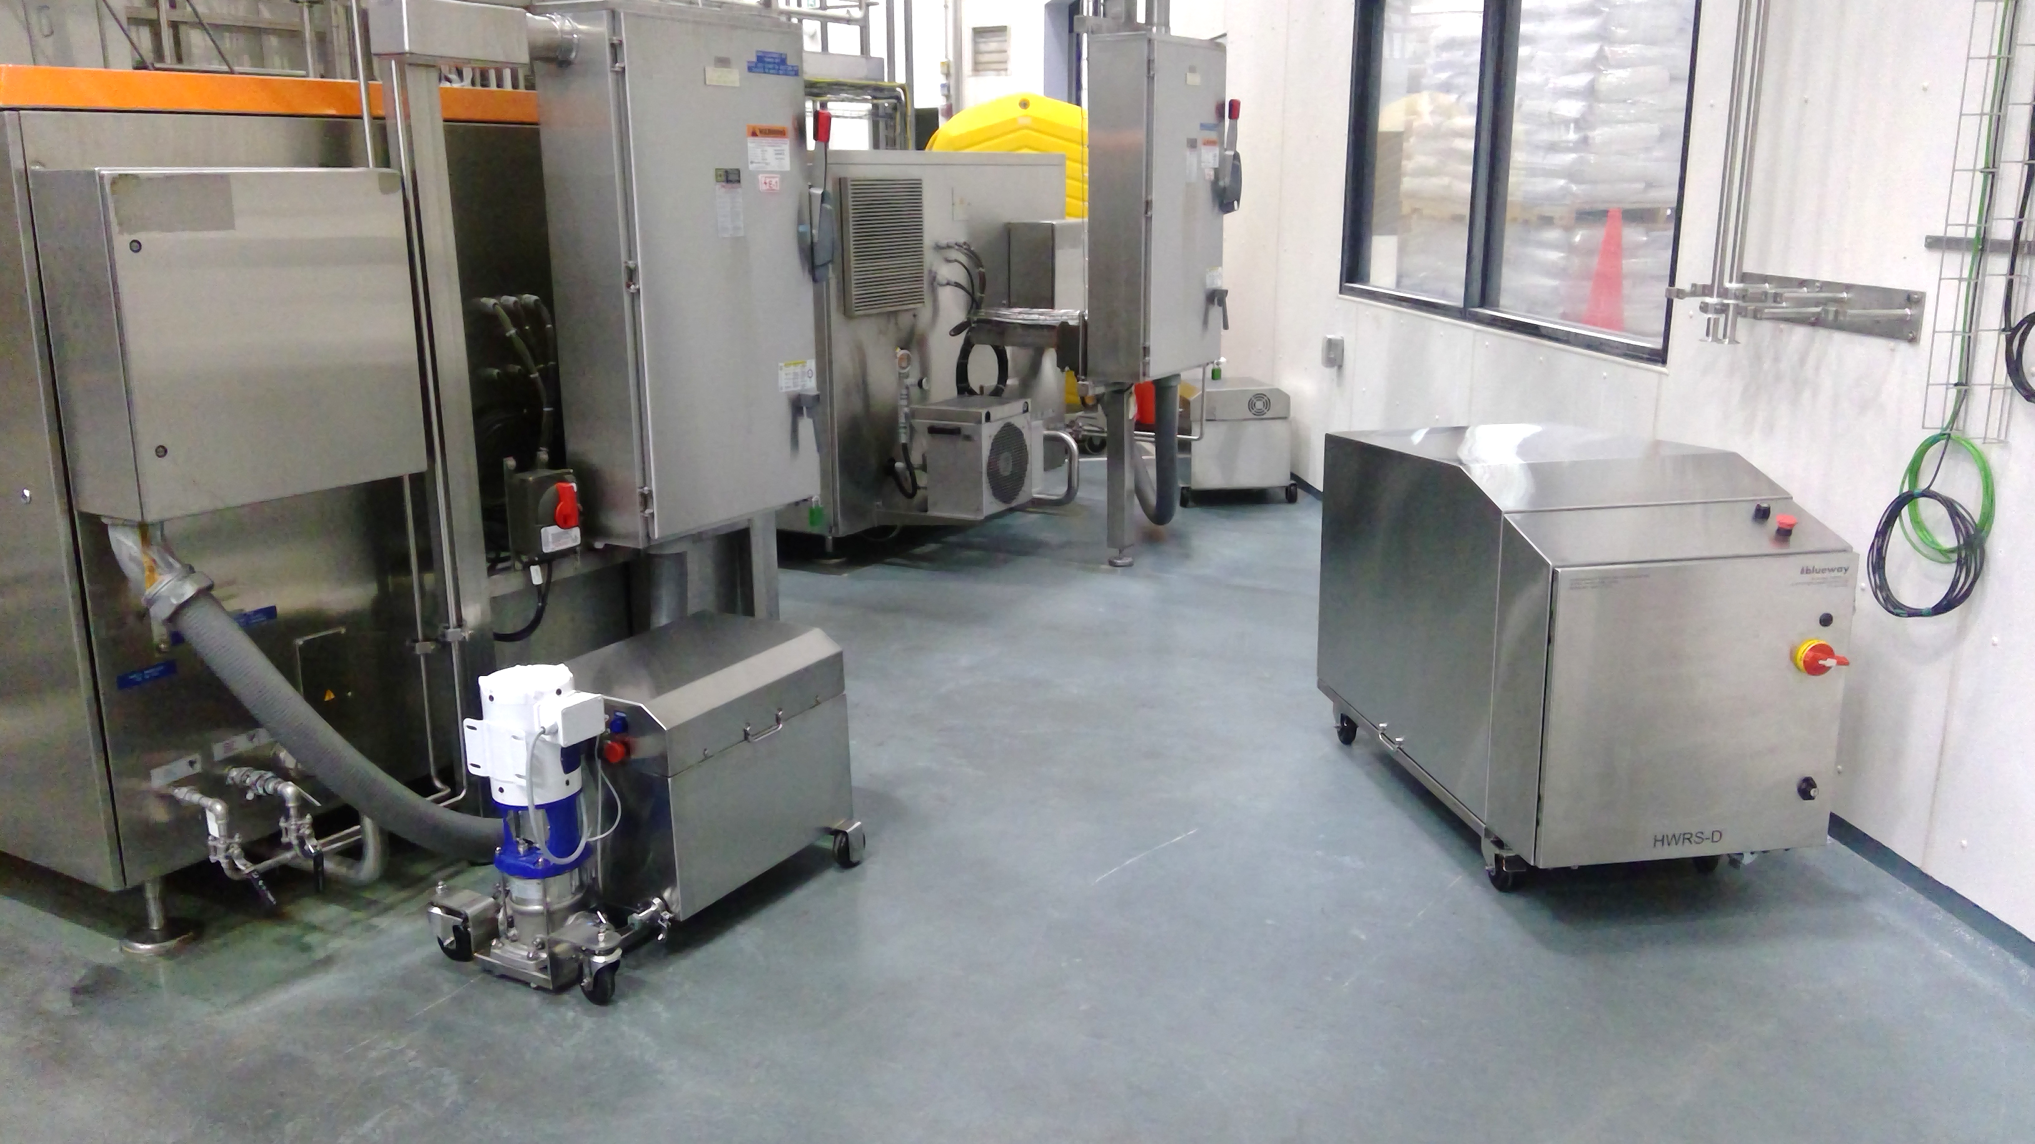
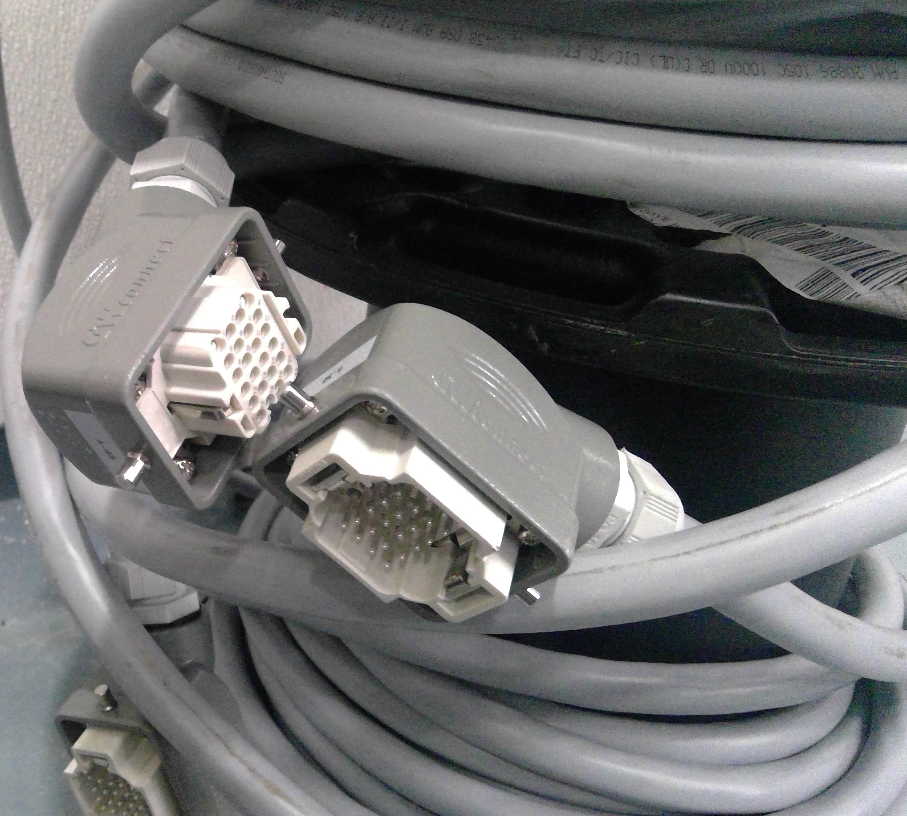
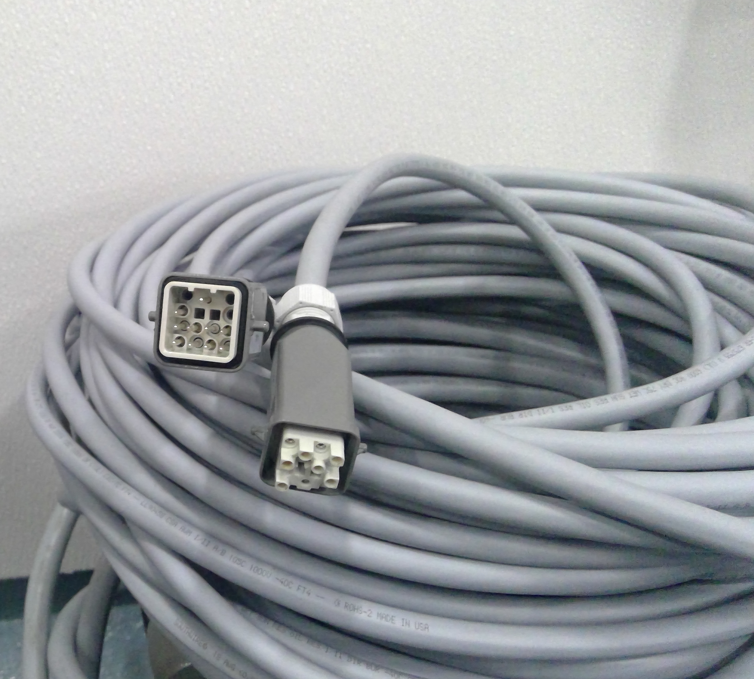
HWRS

Slide 6
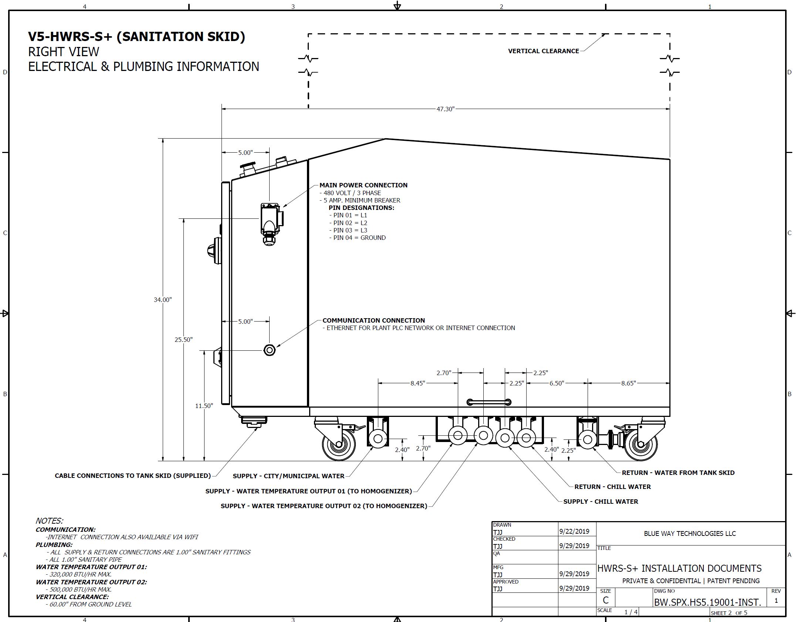
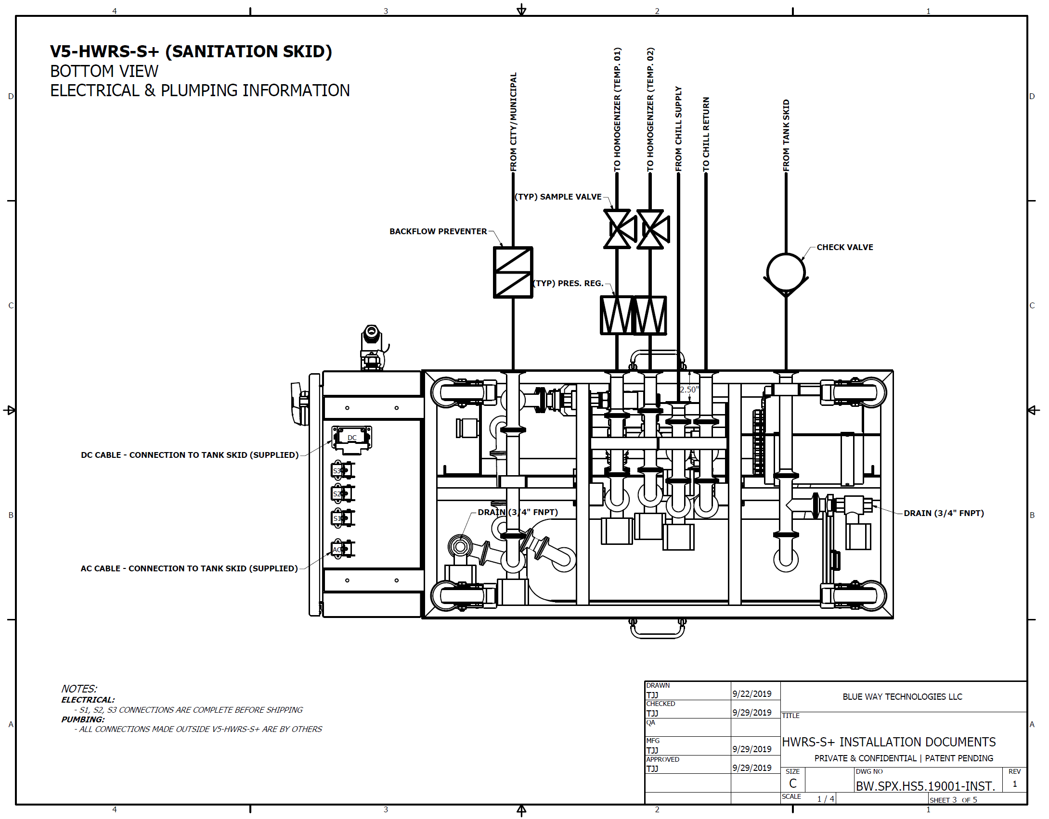
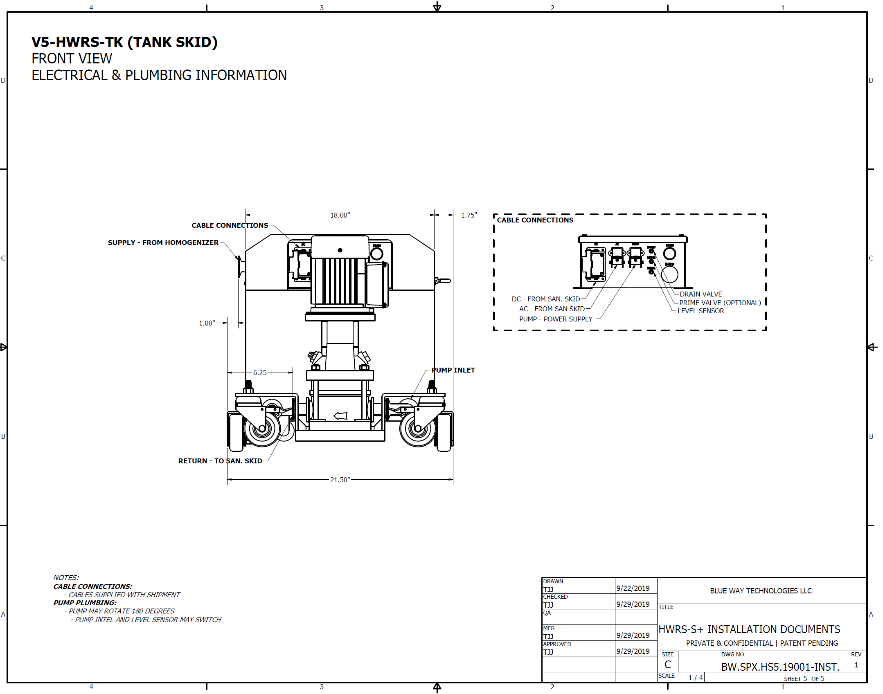
HWRS-S(S+) Installation
Custom documents provided with each installation

Slide 7
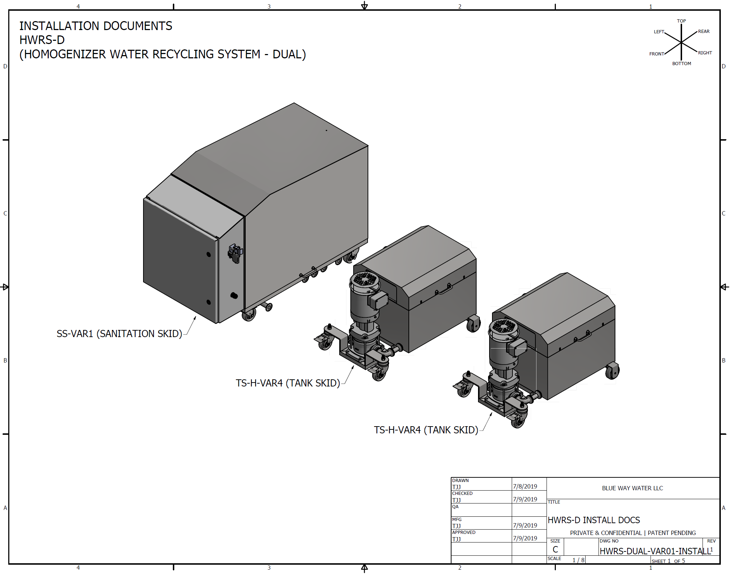
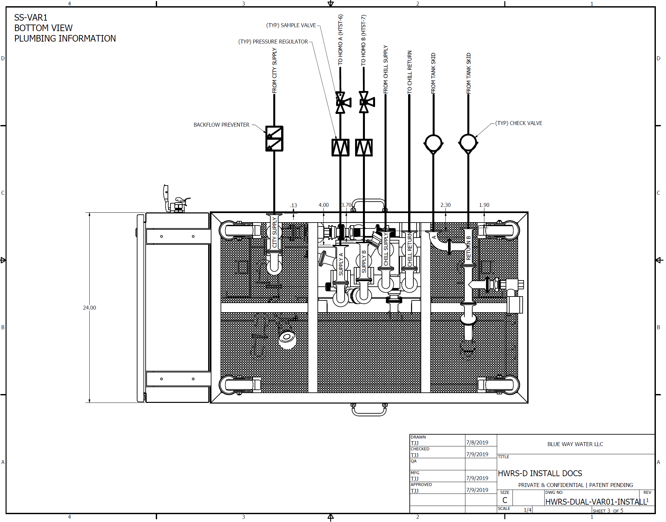
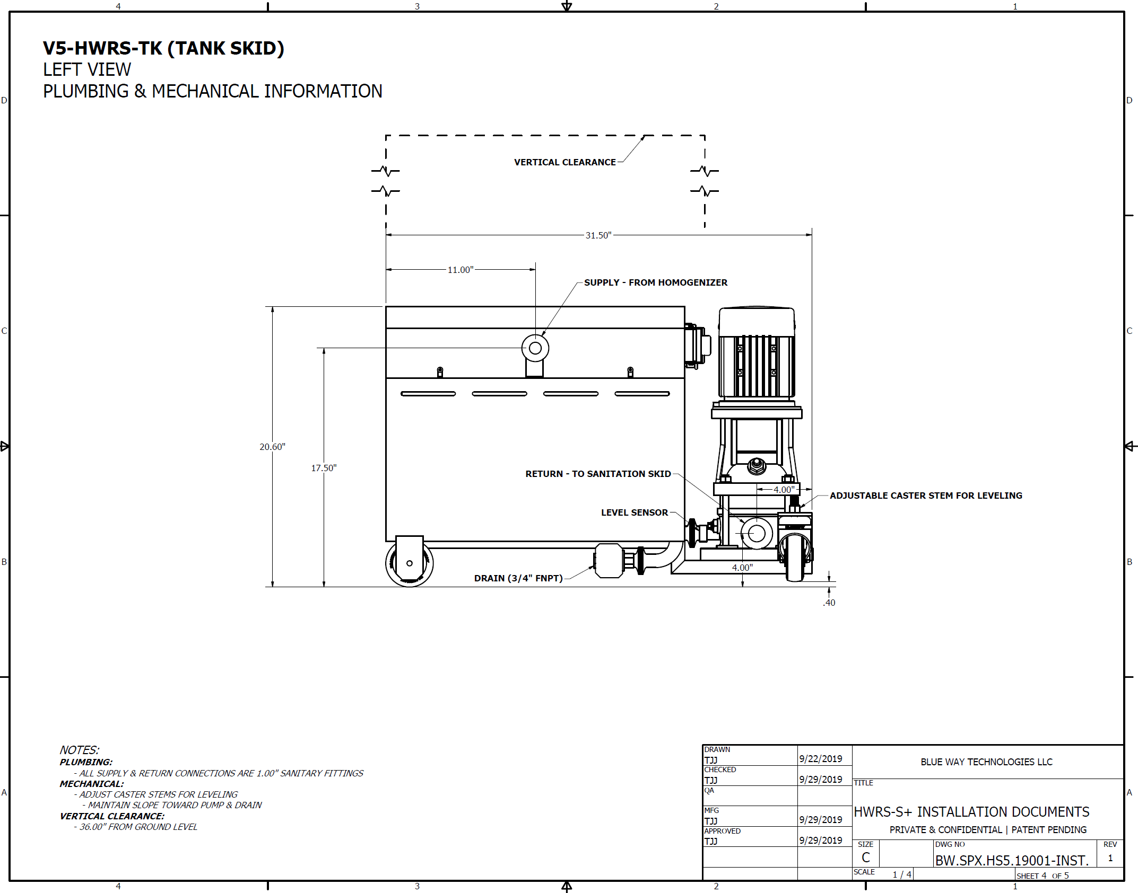
HWRS-D Installation
Custom documents provided with each installation

Slide 8
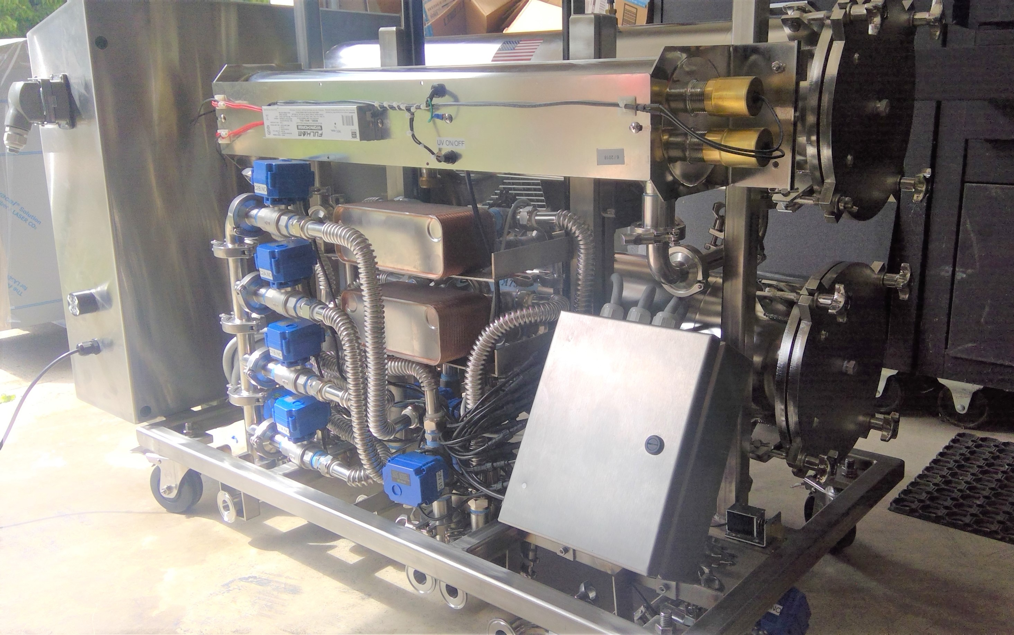
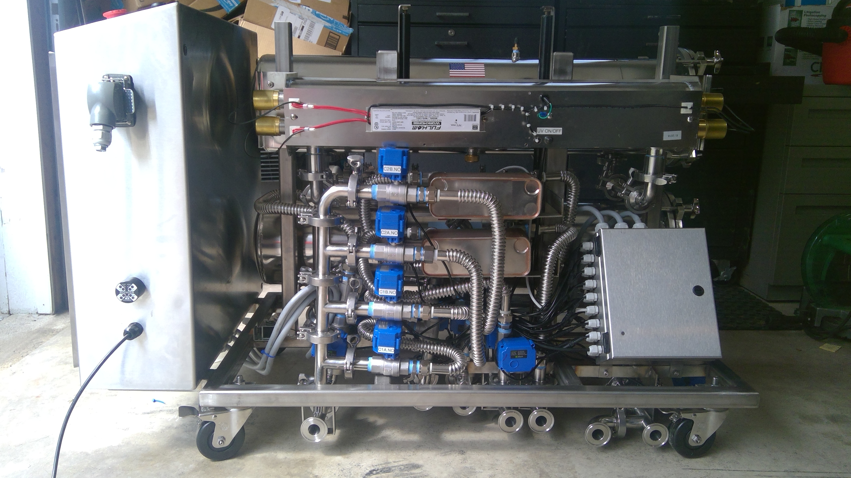
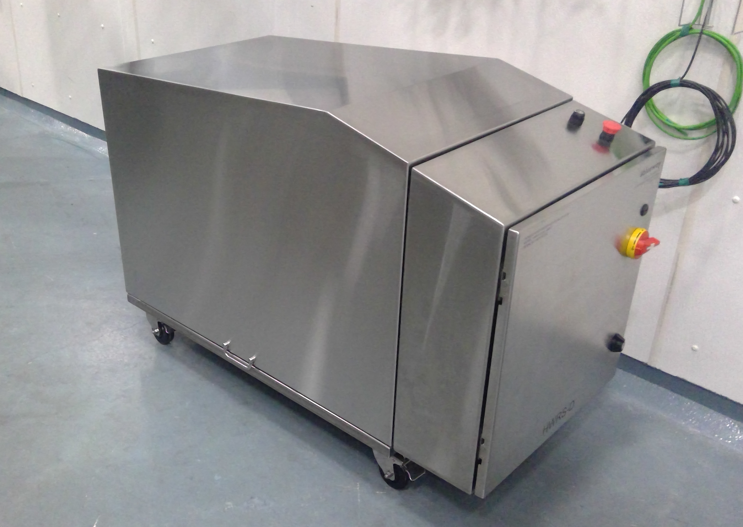
HWRS – Sanitation Skid

Slide 9
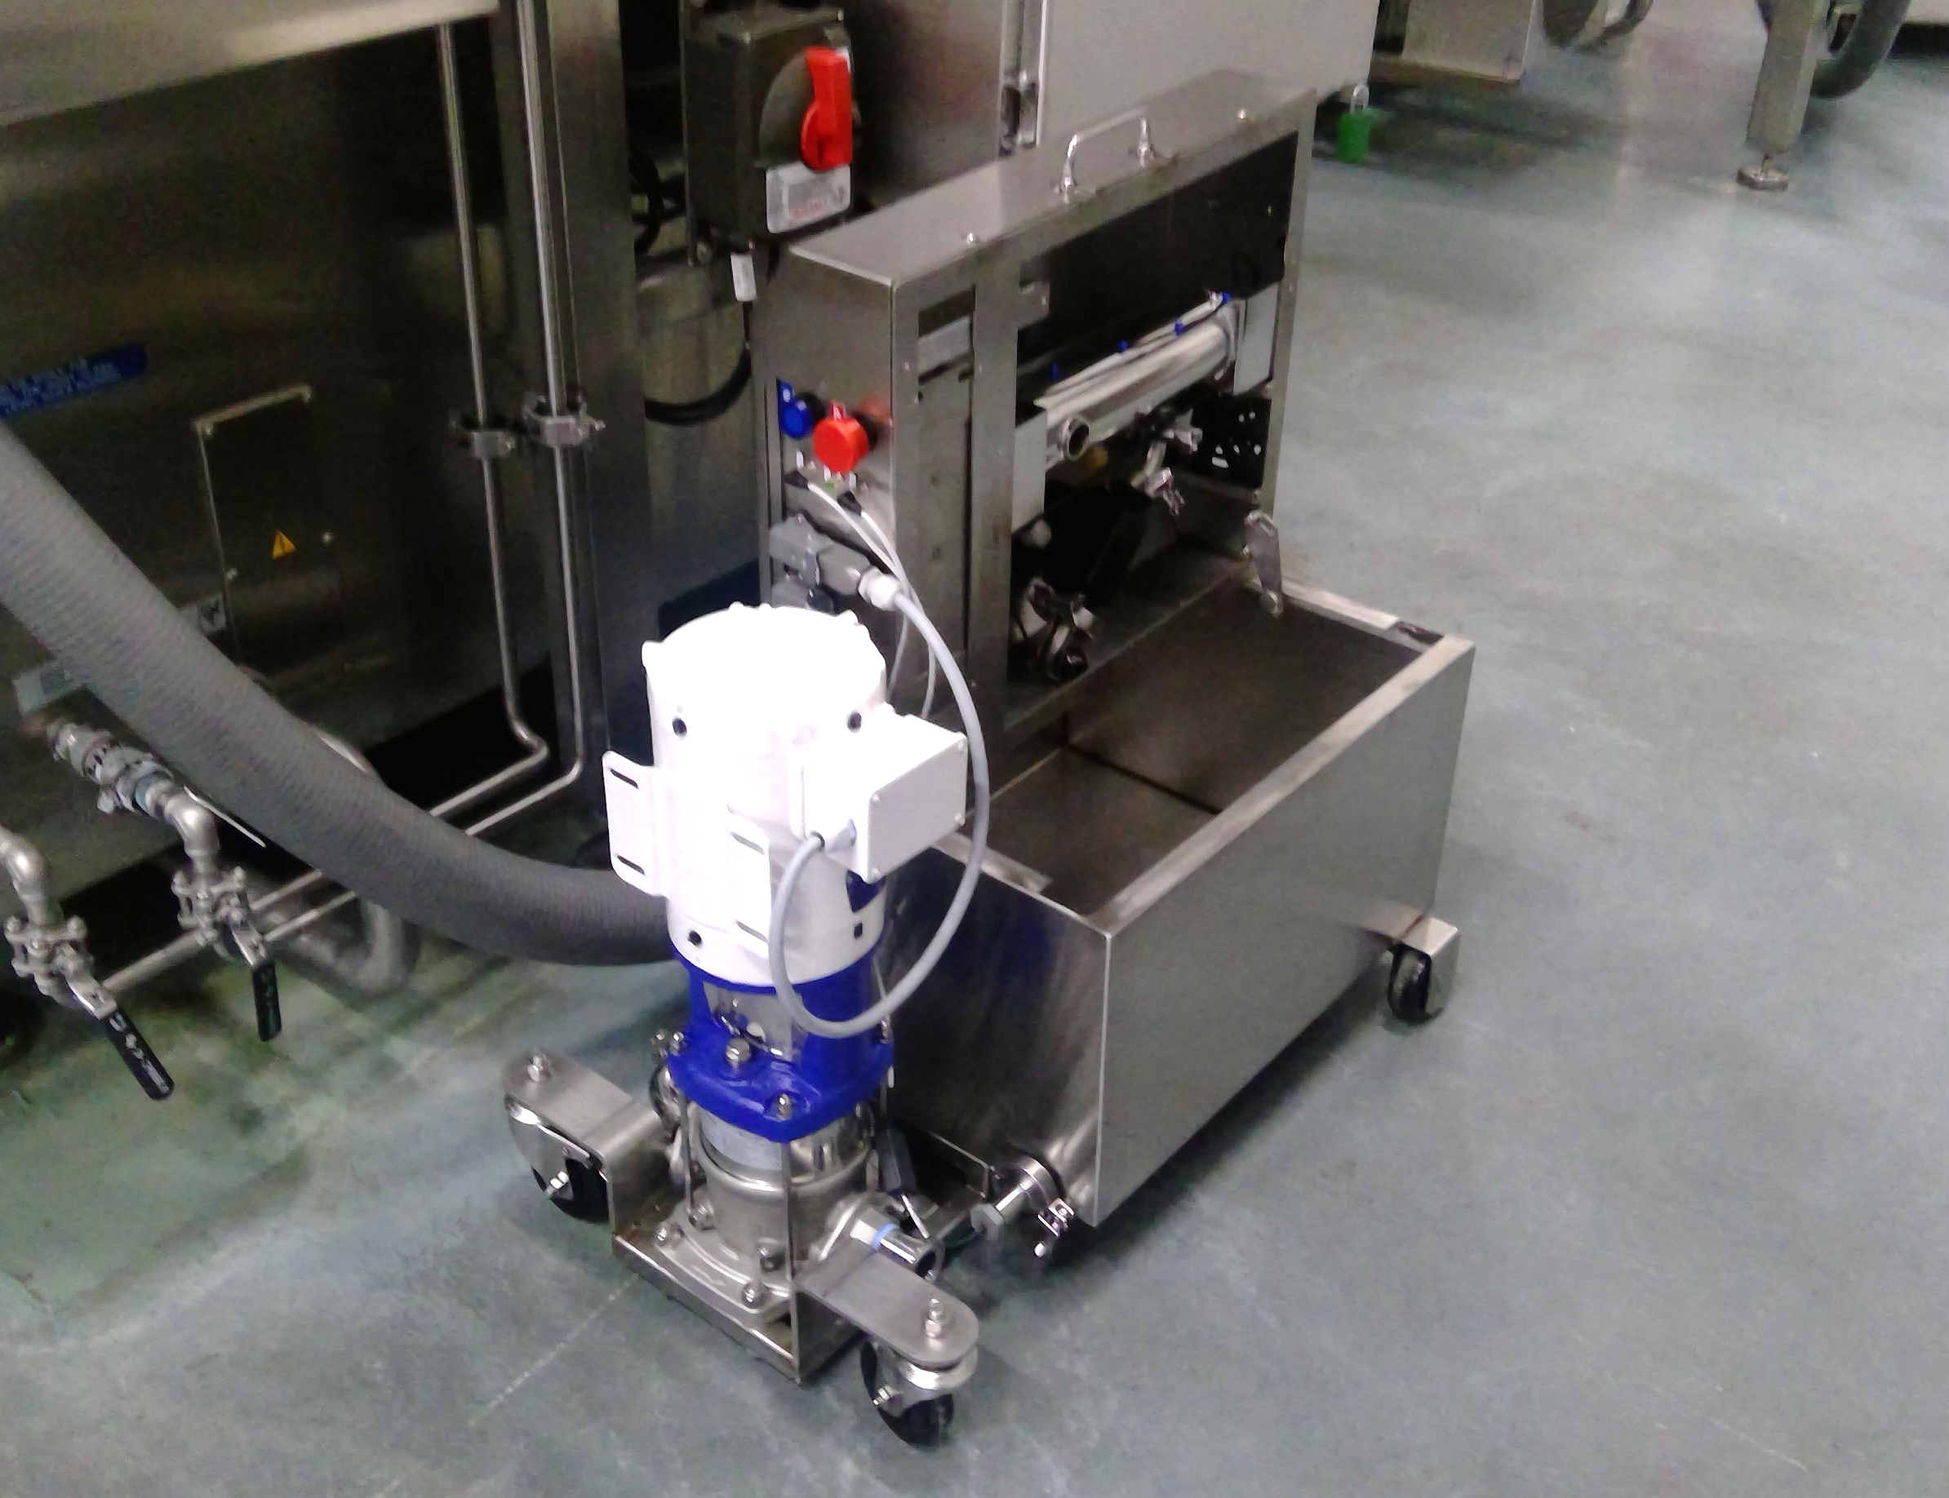
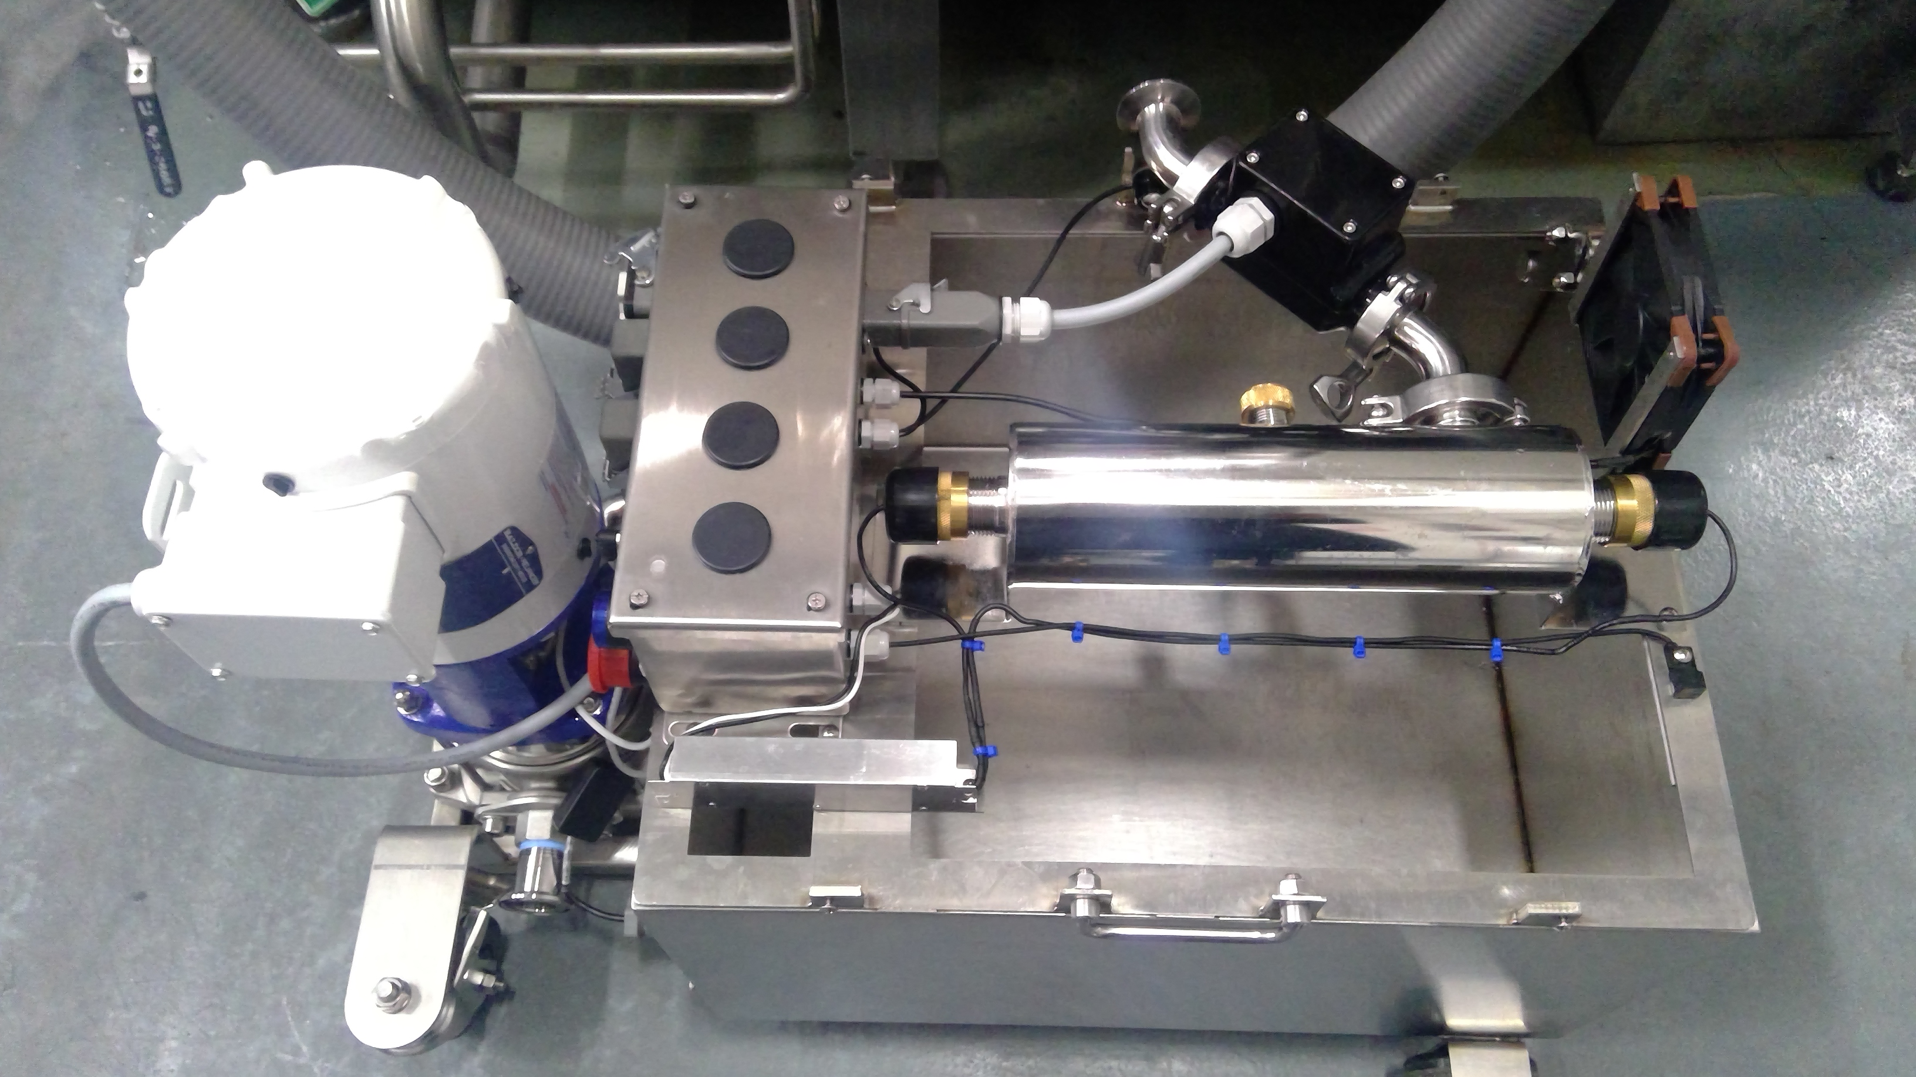
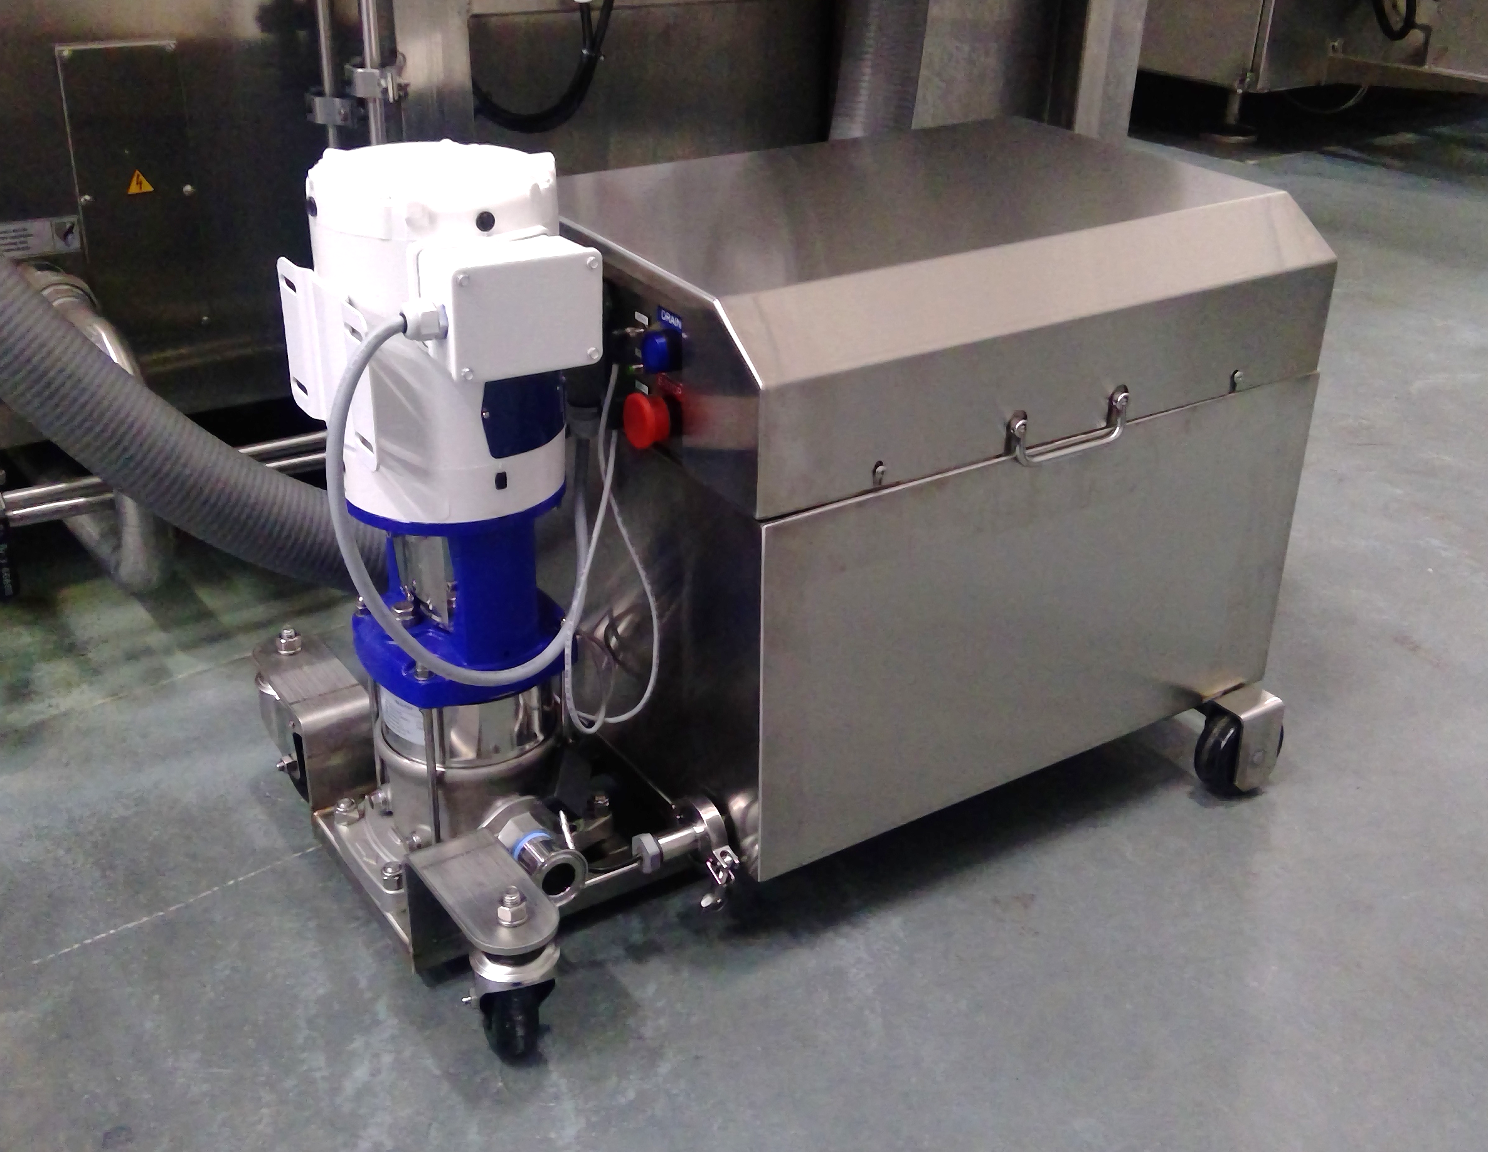
HWRS – Tank Skid

Slide 10
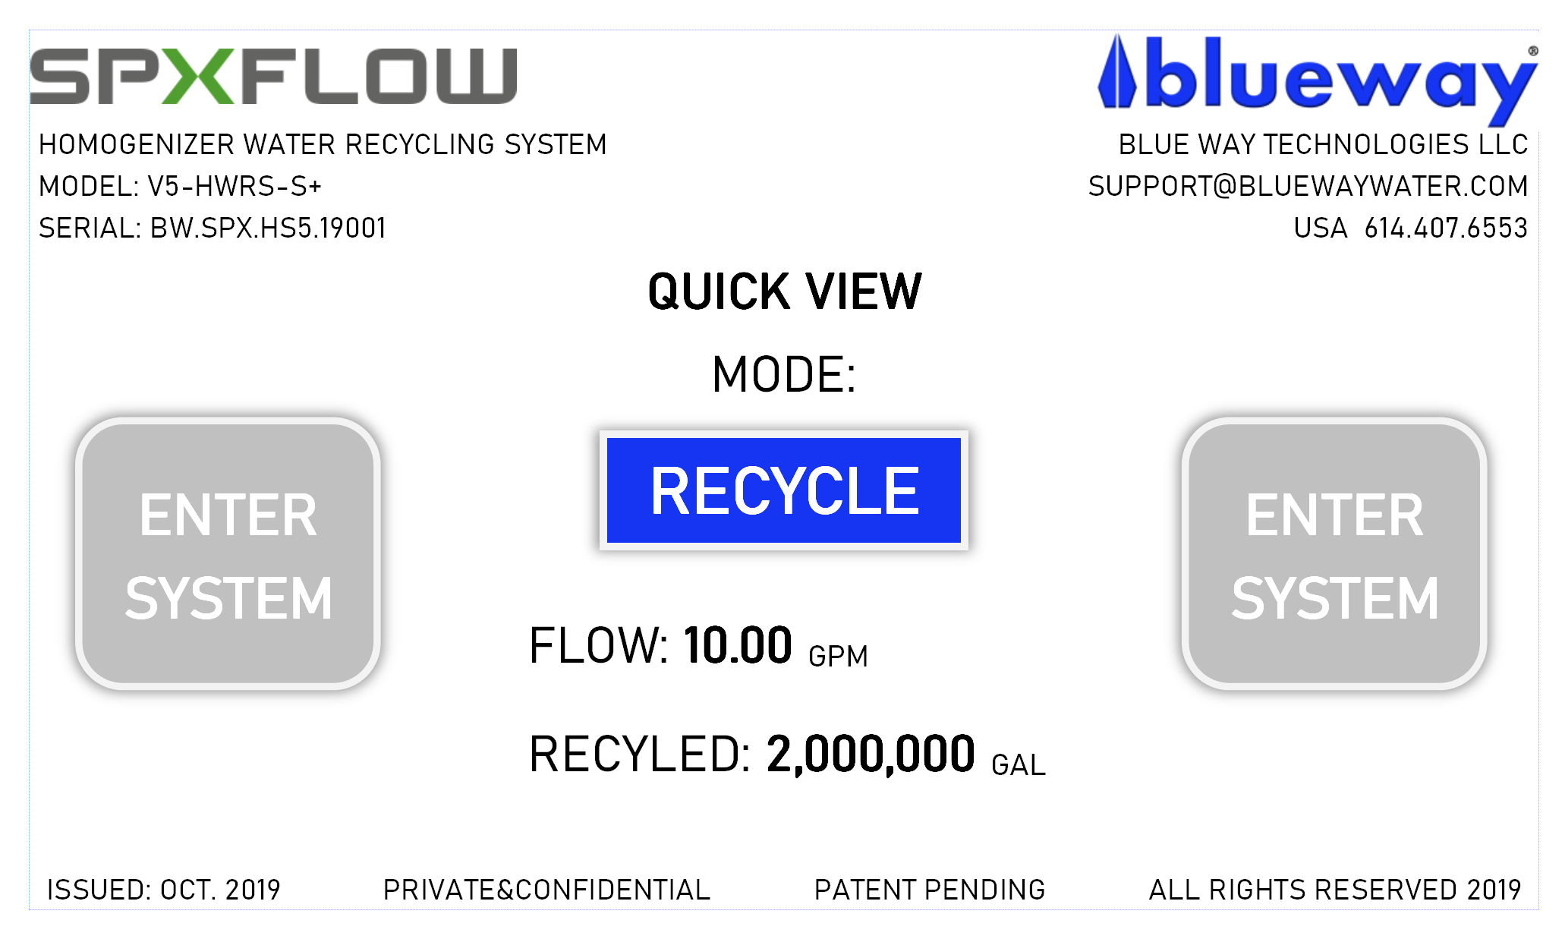
HMI User Screens

Slide 11
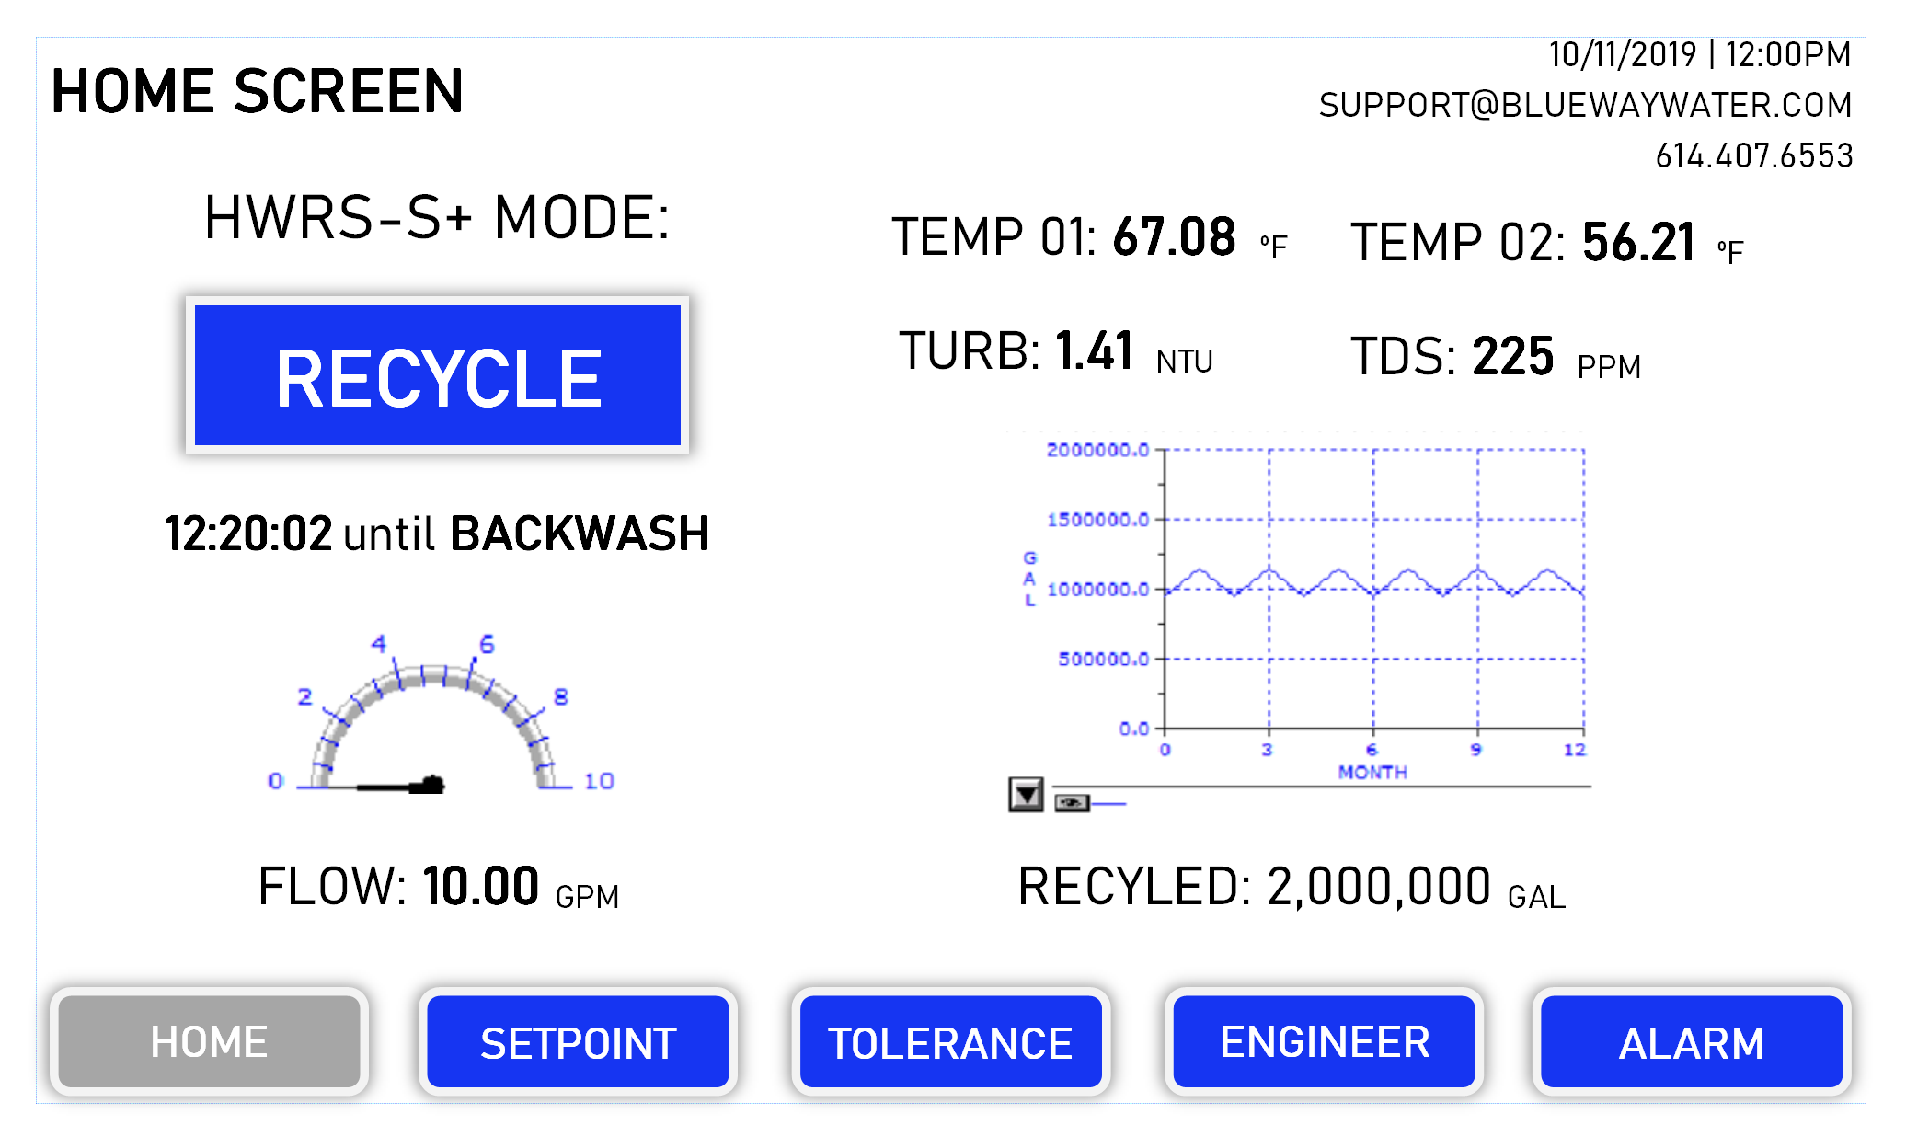
HMI User Screens

Slide 12
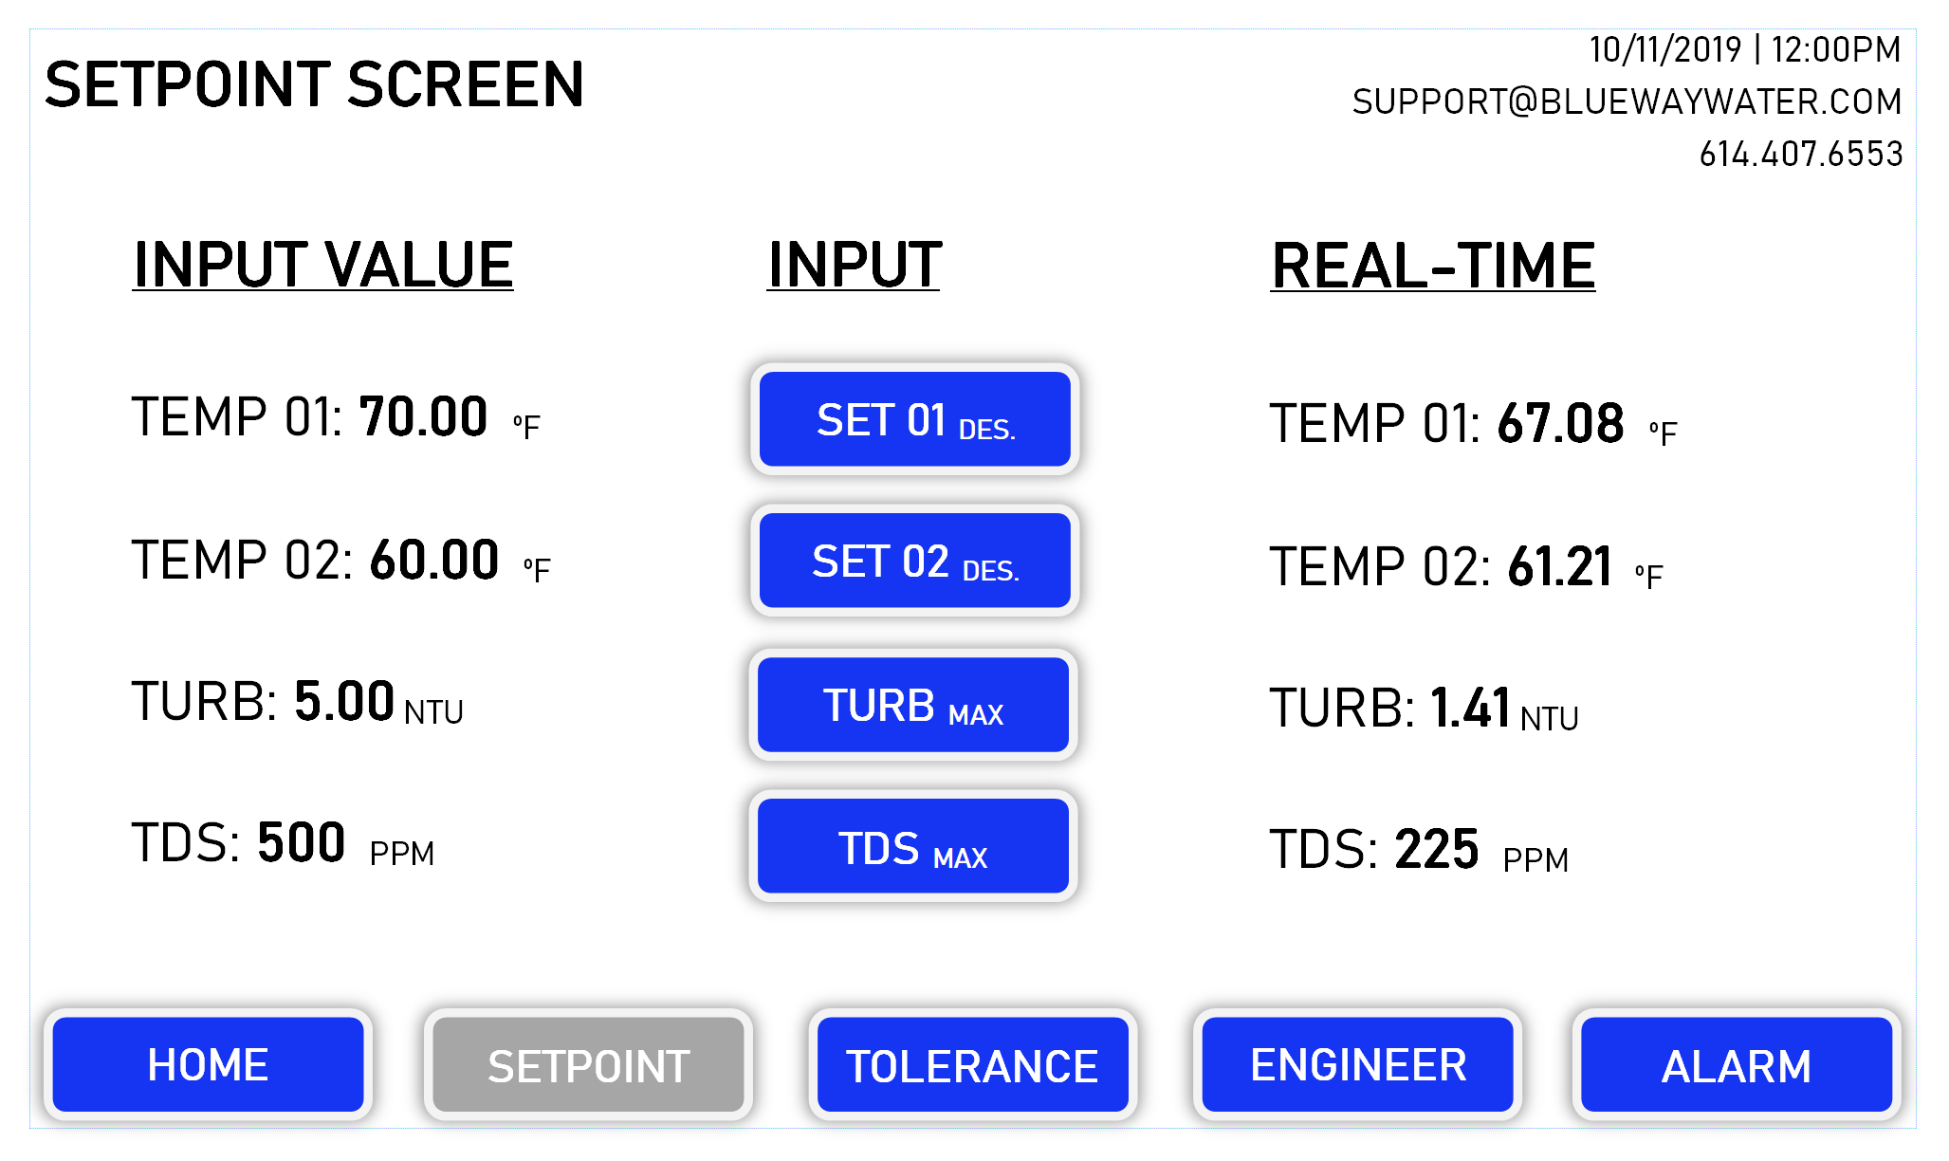
HMI User Screens

Slide 13
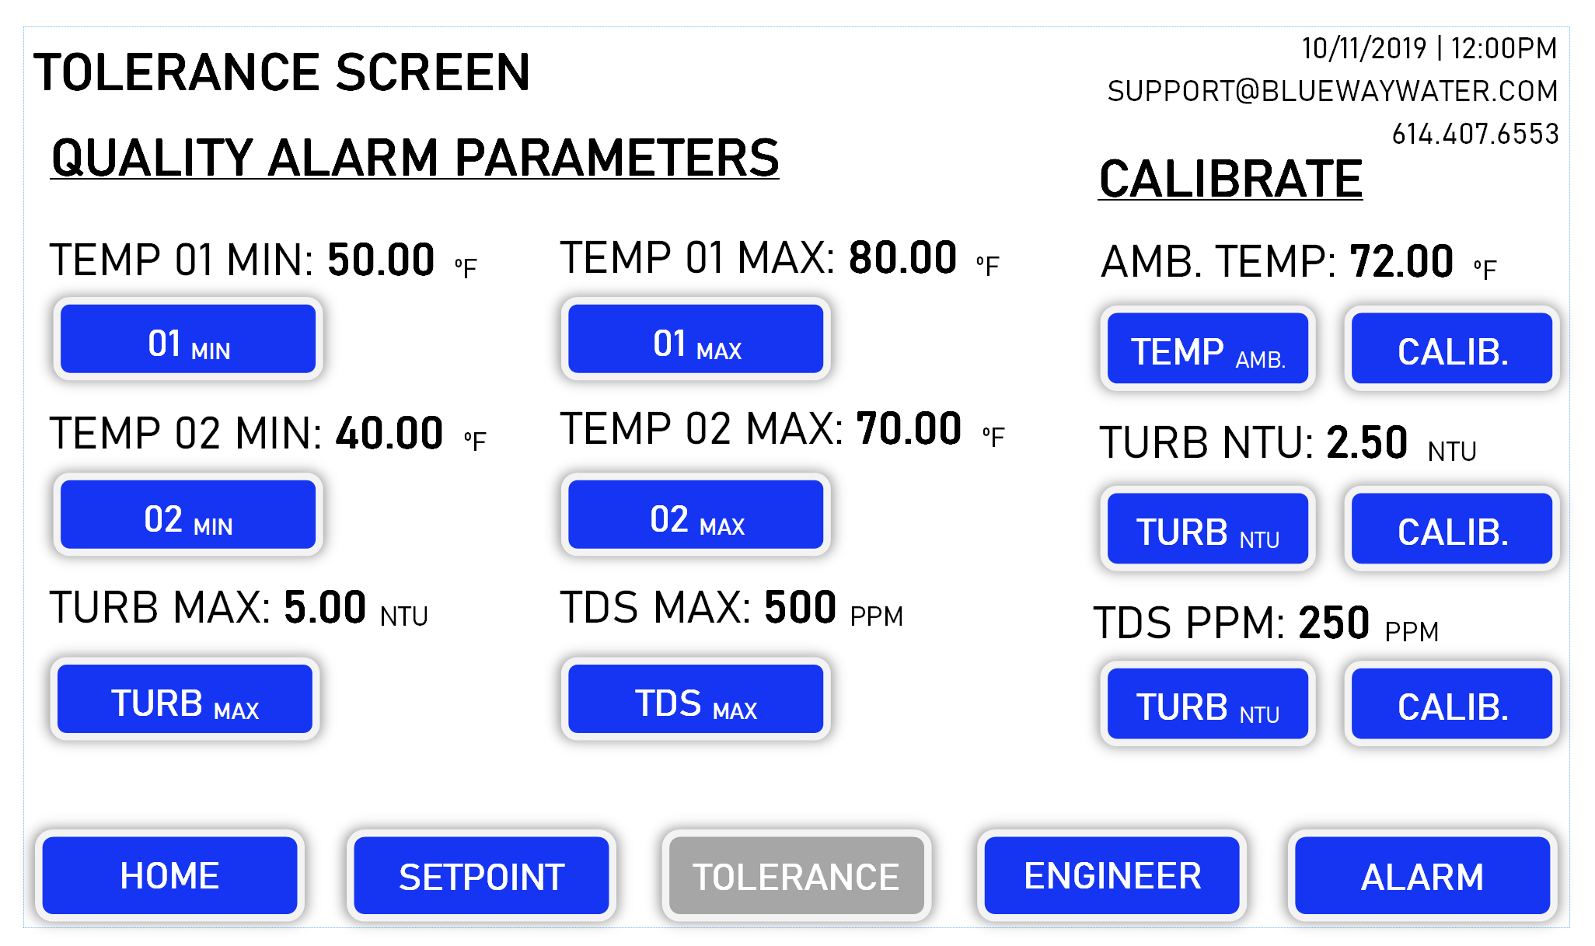
HMI User Screens

Slide 14
HMI User Screens

Slide 15
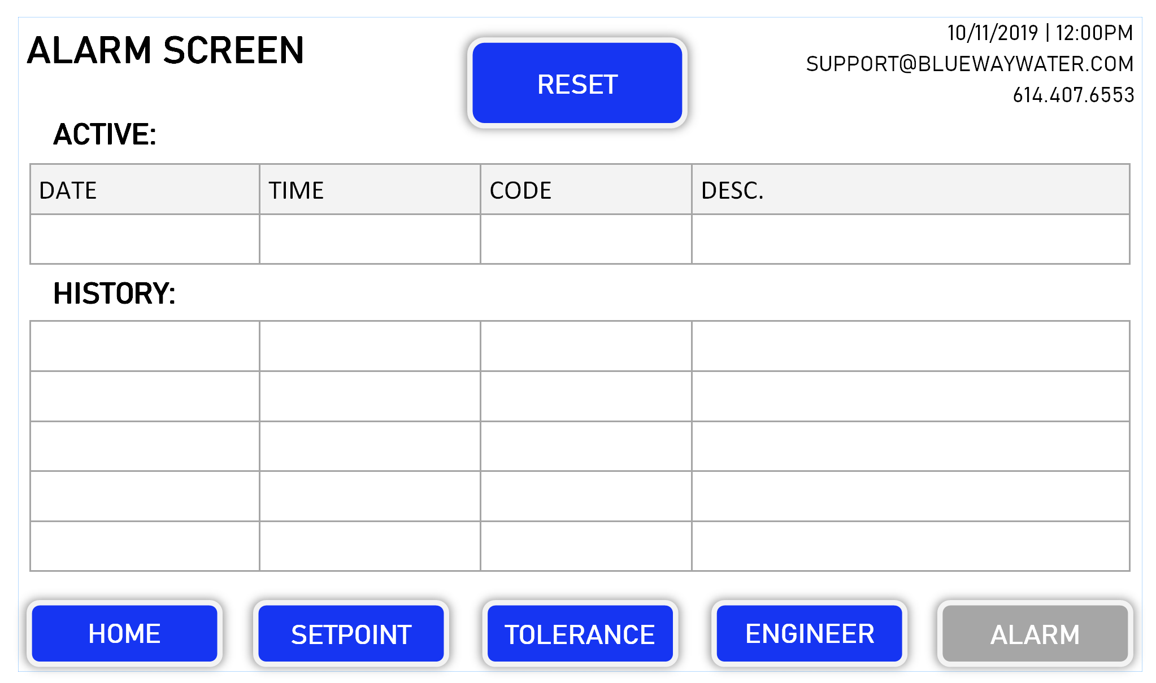
HMI User Screens

Slide 16
Replacement Parts
TM
ASSURED
REPLACEMENT PARTS
Sanitation Skid
(2) UV – annual
(2) Filter – every 2-3 months
Tank Skid (x2 for HWRS-D)
(1) UV – annual
(1) Sensor Array – every 6 months
Software
Annual Update with Recalibration

Slide 17
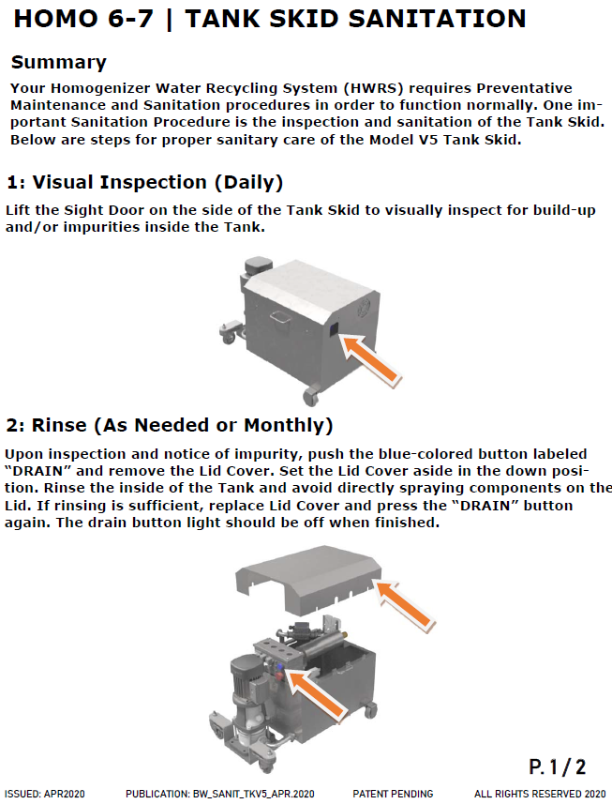
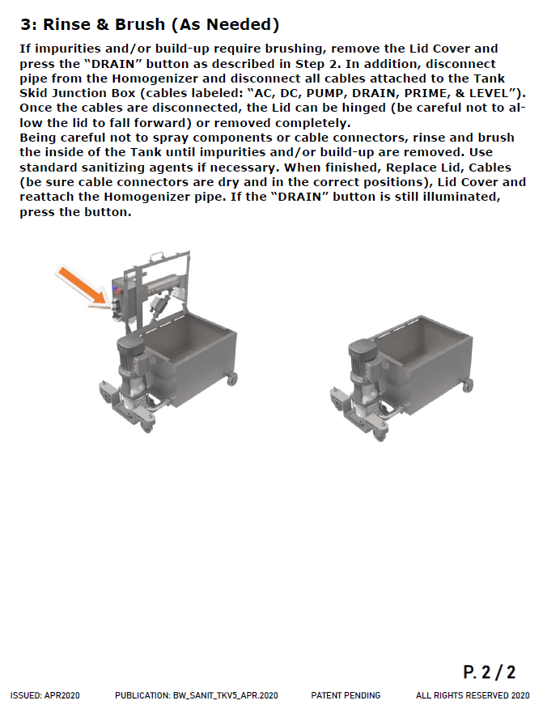
Sanitation & Upkeep
Custom documents provided with each installation

Slide 18
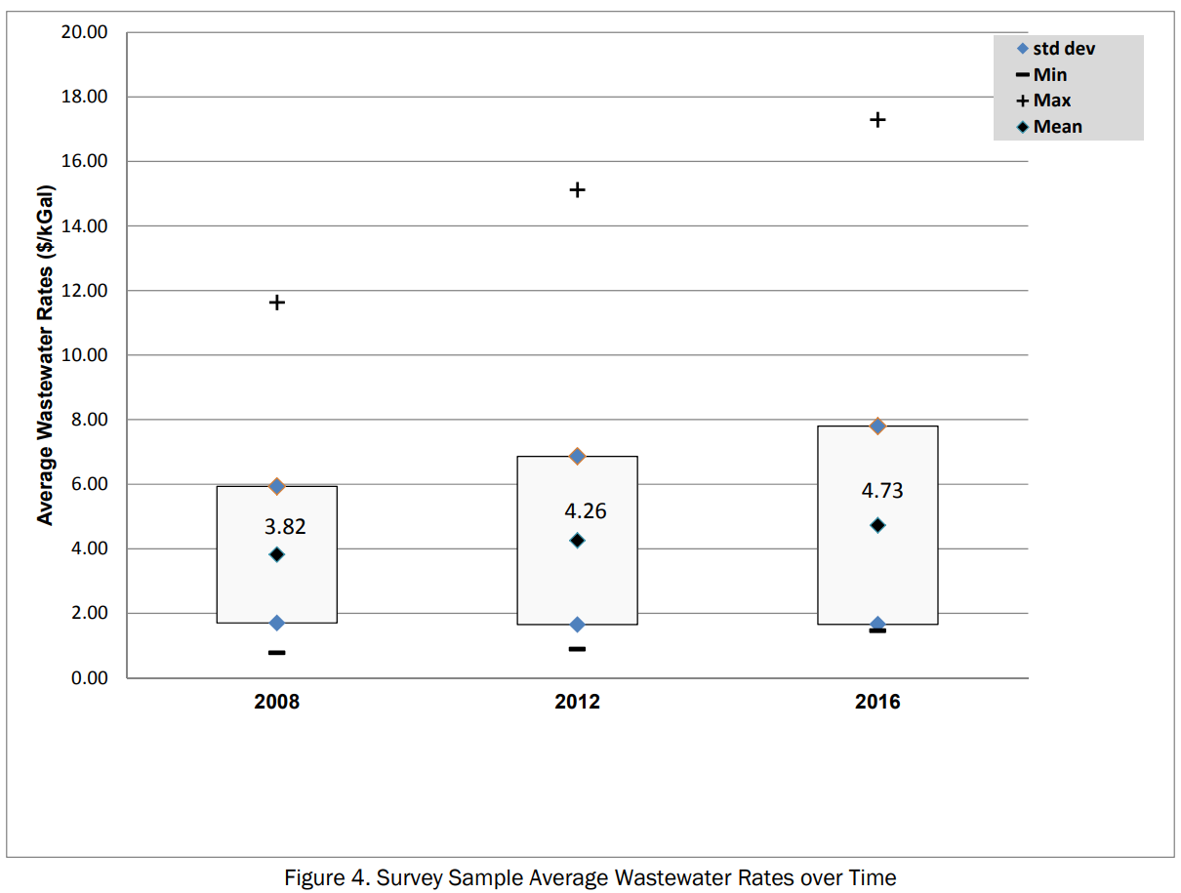
US Water Costs
Water Supply
Wastewater
Source: Water and Wastewater Annual Price Escalation Rates for Selected Cities across the United States (https://www.energy.gov/sites/prod/files/2017/10/f38/water_ wastewater_escalation_rate_study.pdf)

Slide 19
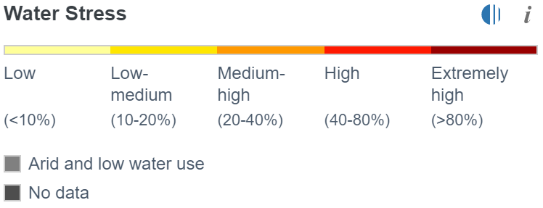
Water Stress
Definition: Baseline water stress measures the ratio of total water withdrawals to available renewable surface and groundwater supplies. Water withdrawals include domestic, industrial, irrigation, and livestock consumptive and non-consumptive uses. Available renewable water supplies include the impact of upstream consumptive water users and large dams on downstream water availability. Higher values indicate more competition among users.
Source: https://www.wri.org/applications/aqueduct/water-risk-atlas/#/?advanced=false&basemap=hydro&indicator=bws_cat&lat=36.89719446989036&lng=-95.86669921875001&mapMode=view&month=1&opacity=0.5&ponderation=DEF&predefined=false&projection=absolute&scenario=optimistic&scope=baseline&timeScale=annual&year=baseline&zoom=5

Slide 20
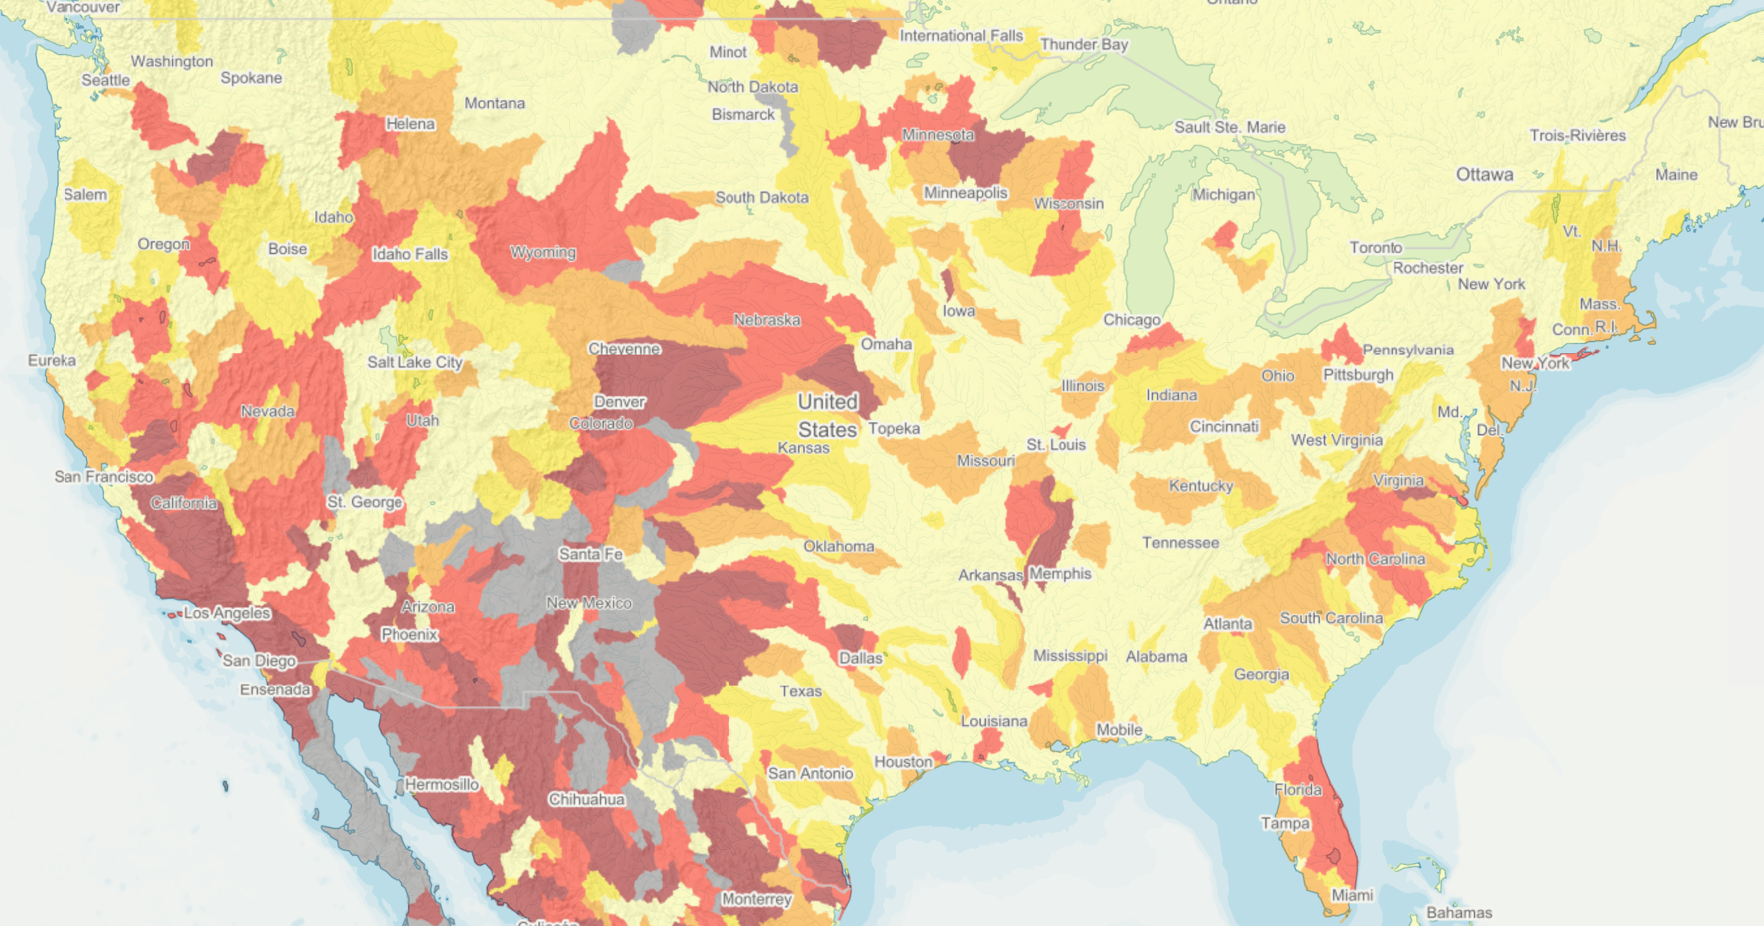
US Water Stress Map

